Slide 1
Weather Anomaly Detection System
Team Members
Joseph Aguirre, Lead Programmer
Andre De La Cruz, Analyst
Arturo Delgado, V & V
Juan Rodriguez, Architect
Jesus Tabares, Designer
Software Development Advance Technology

Slide 2
Outline
Project Description
Elicitation
Use Case
Class Diagram
Dataflow Diagram
State Chart Diagram
Software Requirement Specification
Validation and Verification
Team Growth
Next Phase

Slide 3
Project Description
Common General Terms:
Scope - Range of data subsequence that is being evaluated
Pattern - A high-level abstraction describing a commonly occurring property about a dataset
Data Properties - Combination of scope and pattern
Anomaly - Data that is received that is within the scope and falls outside of a pattern of a data property
Notes:
Explalin the reason for the system

Slide 4
Project Description
Research scientist have been gathering environmental data from various sensors across different geographical locations. The system propose has been task to detect anomalies and notify the scientist to manage those anomalies.
Why are we building the system?
Main Functionalities of the system?
Who will be using the system?

Slide 5
Project Description
Scope[Dataset X, Initial Reading, Final Reading]
Global
Before R
After L
Between L and R
After L until R
Pattern
Universality: Always holds true
Absence: Never holds true
Existence: At some point, a condition holds true
Relation Response: Reaction

Slide 6
Outline
Project Description
Elicitation
Use Case
Class Diagram
Dataflow Diagram
State Chart Diagram
SRS
Validation and Verification
Team Growth
Next Phase

Slide 7
Elicitation
Elicitation technique used was interview with the client
Through the interview we were able to construct:
Project Description
Interview Report
Prototype
Memo
Other Technique not used
Questionnaires
User Observations
Workshops

Slide 8
Outline
Project Description
Elicitation
Use Case
Class Diagram
Dataflow Diagram
State Chart Diagram
SRS
Validation and Verification
Team Growth
Next Phase

Slide 9
Use Case Diagram
Actor
Use Case

Slide 10
Use Case Diagram Iteration 1

Slide 11
Use Case Diagram Iteration 2

Slide 12
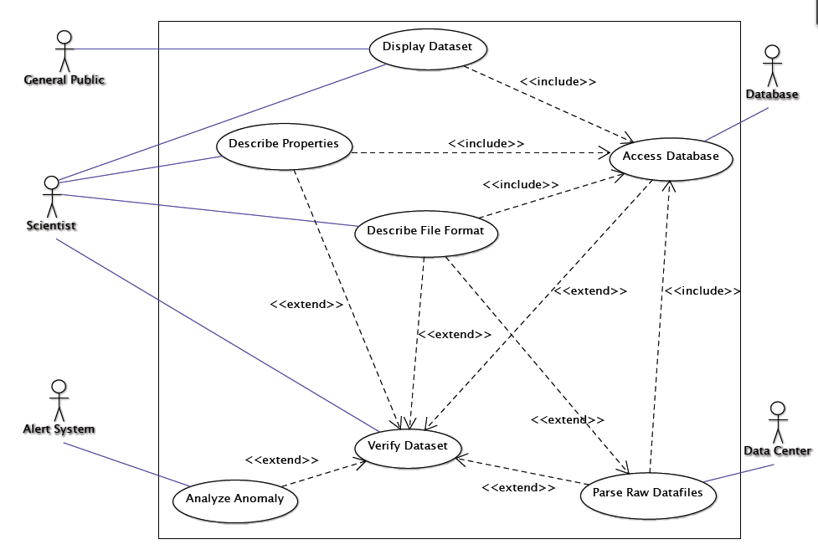
Use Case Diagram Iteration 3
Figure 1 page8

Slide 13
Use Case: Scenario
Scenario 1: Create A New Data Property.
Include Use Case: Access Database.
Description: The Scientist describes a new data property to be saved to the database for later use.
Actors: Scientist, Database.
Pre-Condition: The scientist has logged on to the system and the scientist is a registered user of the system.
Trigger Condition: The scientist has chosen the option to describe a new property.

Slide 14
Use Case: Scenario
1. The system displays a form where the scientist can specify a scope, a pattern, a data file they wish to associate the data property with, and any other general comments he/she may have.
2. The scientist selects the save data property option.
3. The System accesses the database.
4. The database stores the user specified data property along with the scientist’s general information (i.e. name, number, place of study at the time, etc.) (Alt 1).
5. The system informs the user that the property has been saved to the database.
6. End of use case.

Slide 15
Use Case: Scenario
Alt 1: Property created already exists.
4.1. The database generates a message to the system signifying that the specified data property already exists in the database.
4.2. The system generates a message to the scientist that the specified data property already exists in the database and asks the user if they wish to view the property in the database.
4.3. The scientist choses the option to view the data property (Alt 2).
4.4. The system accesses the database to view the data property information.
4.5. The database retrieves the data property information and sends it to the system.
4.6. The system presents the user with the data property information.
4.7. The scientist closes the presented data property information.
4.8. End use case.
Alt 2: Scientist does not wish to view found property.
4.3.1. The scientist choses to not view the data property information.
4.3.2. End use case.

Slide 16
Outline
Project Description
Elicitation
Use Case
Class Diagram
Dataflow Diagram
State Chart Diagram
SRS
Validation and Verification
Team Growth
Next Phase

Slide 17

Class Diagram
Notation
Association
General binary relationships between classes
Generalization
The specific classifier inherits part of its definition from the general classifier.
Aggregation
Special form of association representing has-a or part-whole relationship.
Composite
Stronger form of aggregation
Implies exclusive ownership of the component class by the aggregate class
Dependency
Relationship between the entities such that the proper operation of one entity depends on the presence of the other entity.

Slide 18
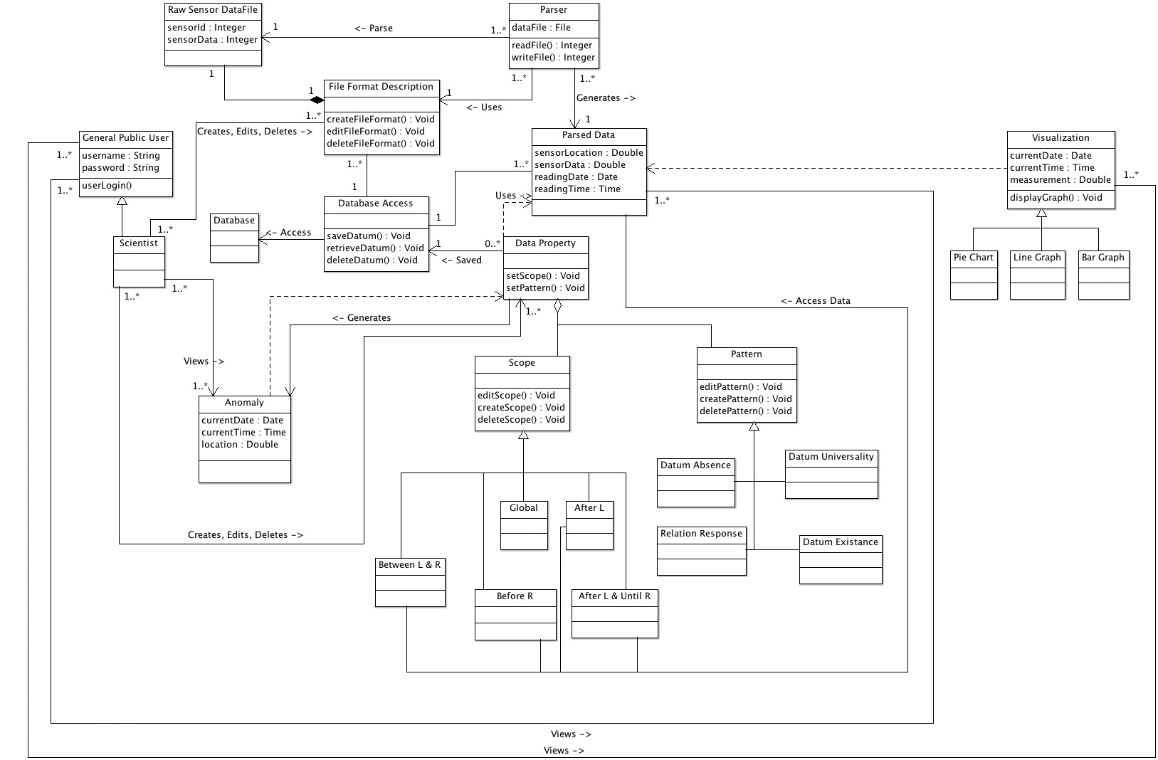
Class Diagram
Appendix A page 29

Slide 19
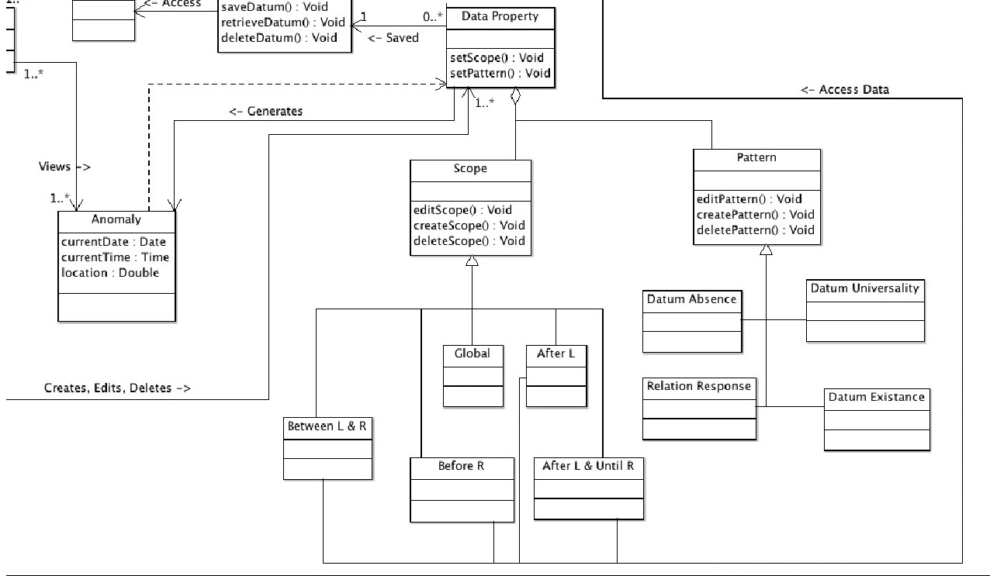
Class Diagram
Appendix A page 29

Slide 20
Class Diagram
Appendix A page 29

Slide 21
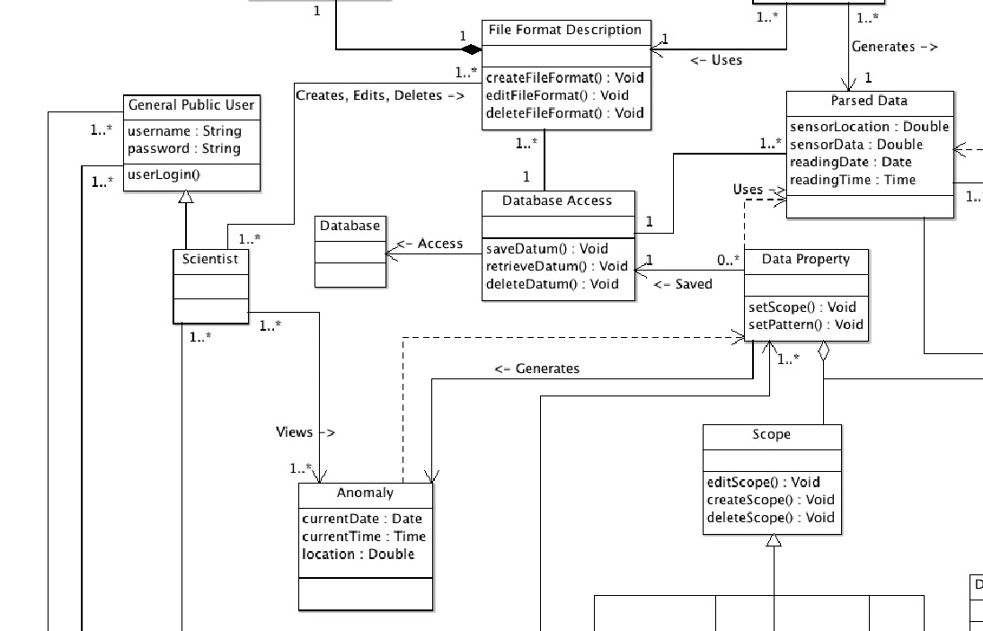
Class Diagram
Appendix A page 29

Slide 22
Outline
Project Description
Elicitation
Use Case
Class Diagram
Dataflow Diagram
State Chart Diagram
SRS
Validation and Verification
Team Growth
Next Phase

Slide 23
Data Flow Diagram
Notation
Process
Data Store
Source or Sink
Flow

Slide 24
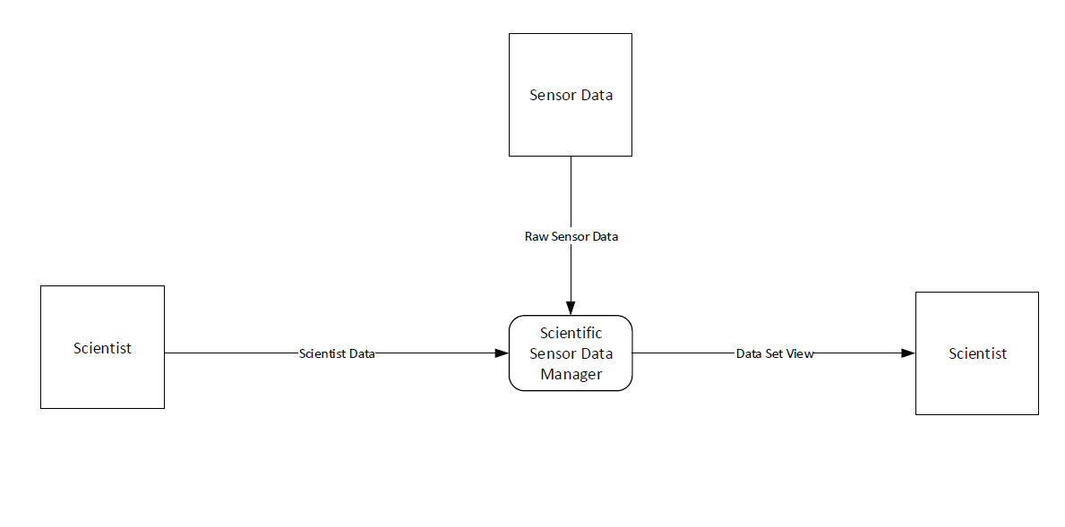
Data Flow Diagram
Level 0
Appendix C page 31

Slide 25
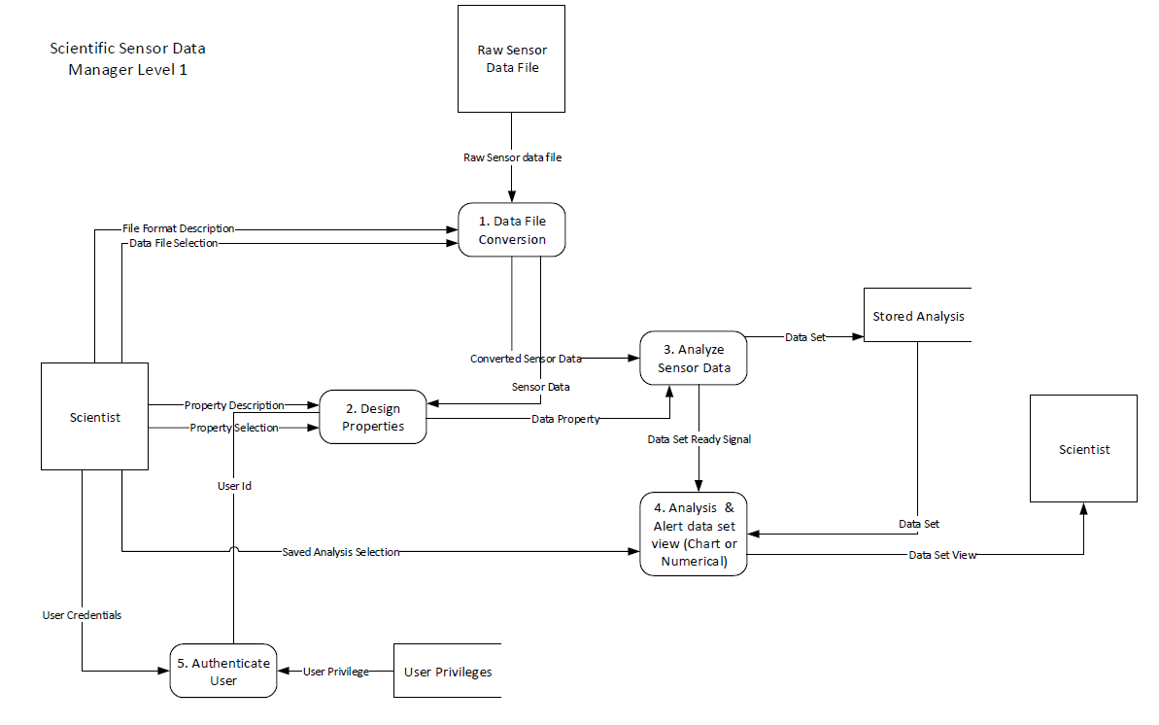
Data Flow Diagram
Level 1: Scientific Sensor Data Manager
Appendix C page 31

Slide 26
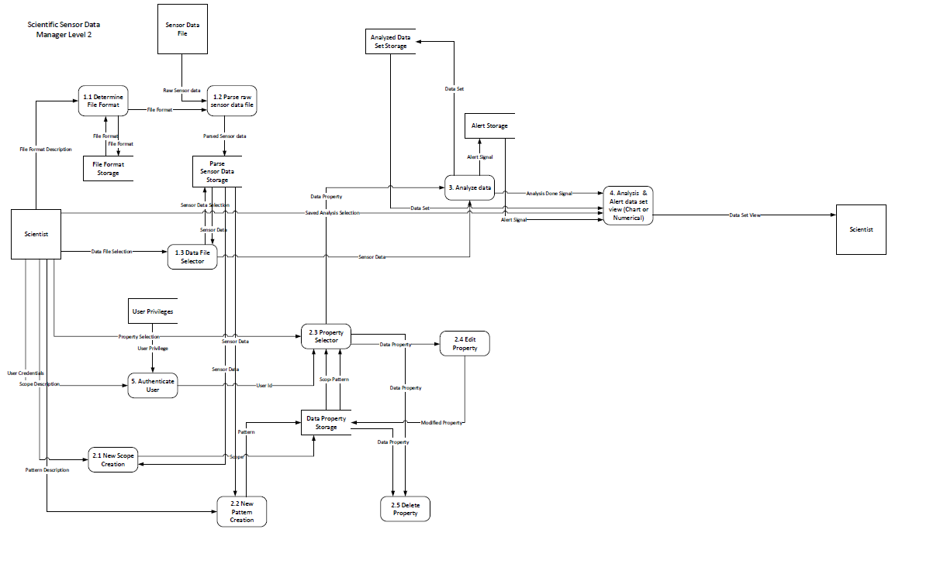
Data Flow Diagram
Level 2
Level 2
Appendix C page 32

Slide 27
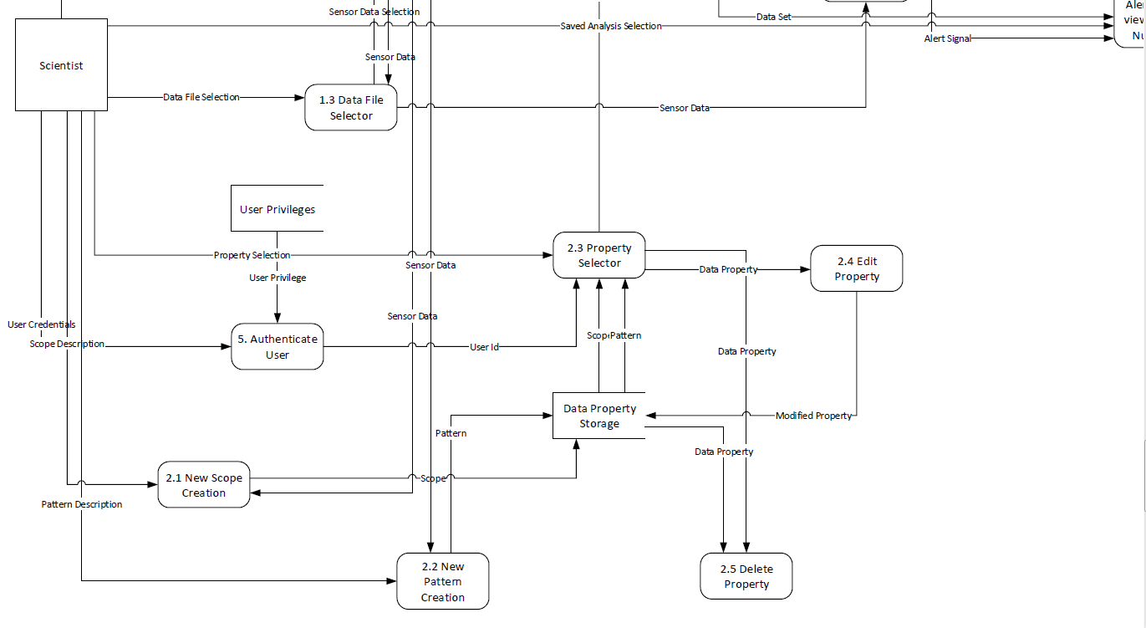
Data Flow Diagram
Appendix C page 32

Slide 28
Outline
Project Description
Elicitation
Class Diagram
Dataflow Diagram
State Chart Diagram
SRS
Validation and Verification
Team Growth
Next Phase

Slide 29
State Chart Diagram
Elements of a State Chart
Initial State
Final State
Transition
Idle
Running
State

Slide 30
State Chart Diagram
Elements of a State Chart
Source
trigger [guard] / action
Target

Slide 31
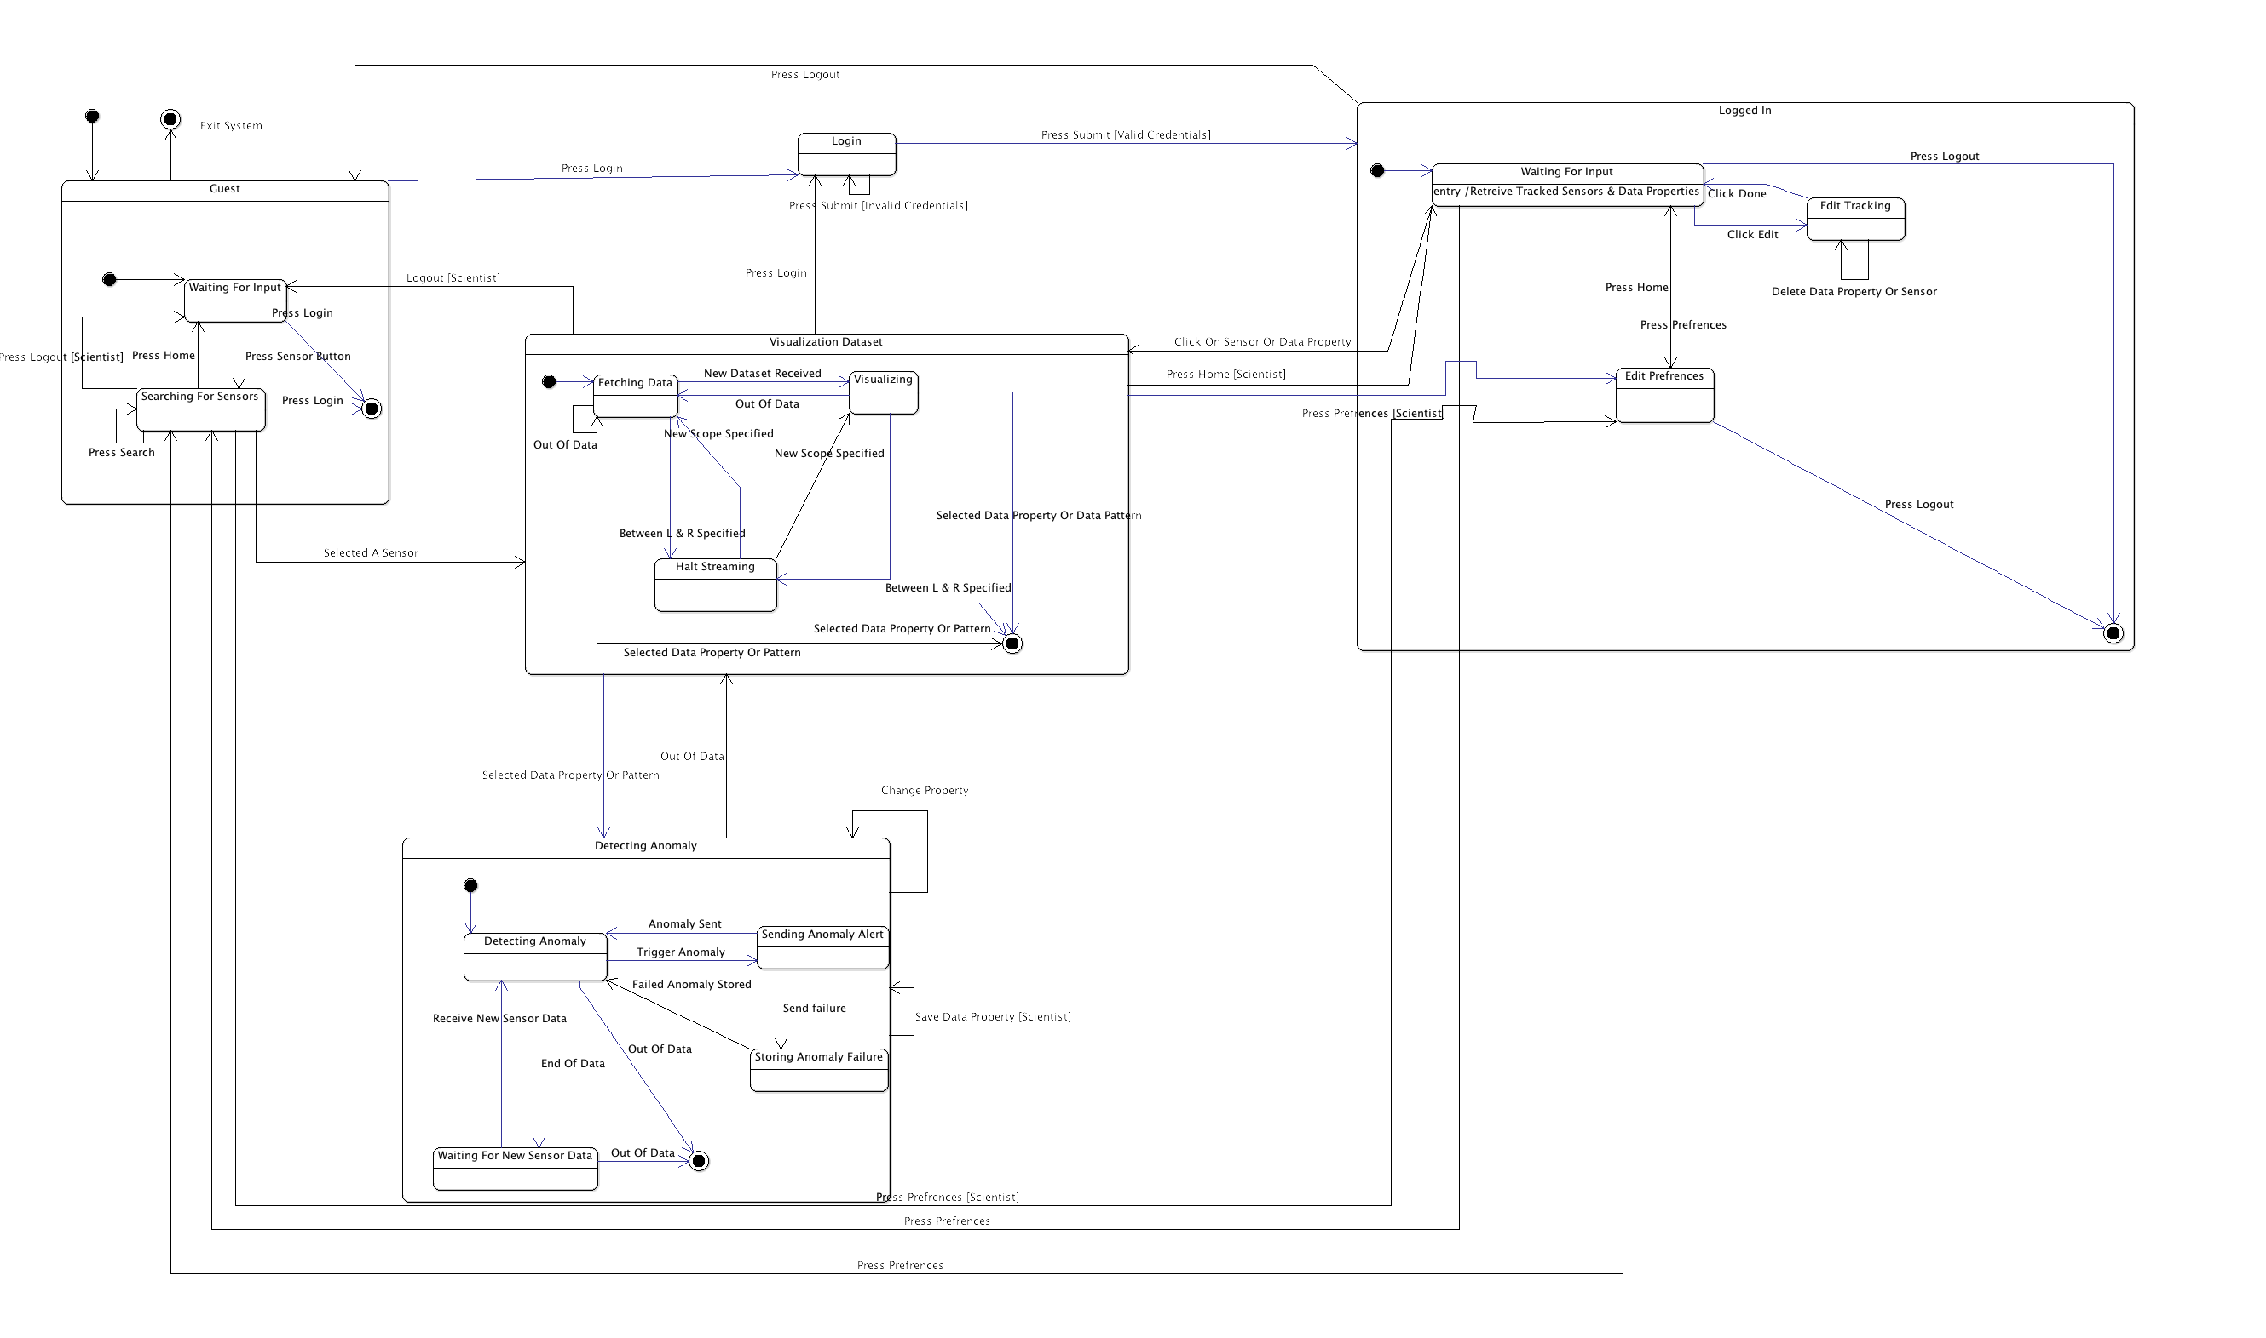
State Chart Diagram
Appendix B page 30

Slide 32
State Chart Diagram
Appendix B page 30

Slide 33
State Chart Diagram
Appendix B page 30

Slide 34
State Chart Diagram
Appendix B page 30

Slide 35
State Chart Diagram
Appendix B page 30

Slide 36
State Chart Diagram
Appendix B page 30

Slide 37
Outline
Project Description
Elicitation
Class Diagram
Dataflow Diagram
State Chart Diagram
SRS
Validation and Verification
Team Growth
Next Phase

Slide 38
Software Requirements Specification (SRS)
SRS is a document containing a complete yet concise description of the entire external interface of the system with its environment including other software, communication ports, hardware, and human users.
Is a contract between development team and the client
Composed of requirements gathered through the elicitation process
Means of controlling system development by limiting any further modifications to the system

Slide 39
Software Requirements Specification (SRS)
A requirement is a user need or a necessary feature, function, or attribute of a system that can be sensed from a position external to that system.
Describes what and not how.
Uses the word shall.
Examples:
The system shall display the current location of a ship.
The system shall generate a dial tone within 5 seconds after a person picks up the receiver.

Slide 40
Software Requirements Specification (SRS)
Consistent if no requirement stated therein is in conflict with other preceding documents and no subset of requirements stated therein conflict.
Correct if every requirement stated therein represents something required of the system to be built.
Unambiguous if every requirement stated therein has only one interpretation.

Slide 41
Software Requirements Specification (SRS)
Verifiable (SRS) A requirement is verifiable if there exists some finite cost-effective process with which a person or machine can check that an actual as-built software product meets the requirements.
Traceable if the SRS is written in a manner that facilitates the referencing of each individual requirement stated therein.
Complete if it possesses:
Everything that the software is suppose to do is included in the SRS.
Definitions of responses of software of all realizable classes of input data in all realizable classes of situations are included
All pages are numbered, all figures and tables are numbered, named, and referenced; all terms and units of measures are provided.
No sections are marked TBD

Slide 42
Software Requirements Specification (SRS)
Structure
Intro
Project description
Specific Requirements
Behavioral Requirements
Non-behavioral Requirements

Slide 43
Outline
Project Description
Elicitation
Class Diagram
Dataflow Diagram
State Chart Diagram
SRS
Validation and Verification
Team Growth

Slide 44
Verification
Ensuring that we build the system correctly
Techniques
Walkthrough: Development team would get together and semi formally go through the documents to make sure there was no inconsistency between documents and diagrams.

Slide 45
Validation
Ensuring that we built the right system
Techniques:
Traceability Matrix helps us make sure requirements gather are all stated in artifacts.

Slide 46
Outline
Project Description
Elicitation
Use Case
Class Diagram
Dataflow Diagram
State Chart Diagram
SRS
Validation and Verification
Team Growth

Slide 47
Team Growth
Group Process
Met as a group twice a week
Met with our mentor
Discussed diagrams & documents
Divide work
Kept meetings
Took minutes
Had an agenda for each meeting

Slide 48
Team Growth
Stages of the Team Growth
Forming
Storming
Norming
Performing
PIGS Face
Positive Interdependence
Individual Accountability
Group Processing
Social Skills
Face to Face Interaction

Slide 49
Outline
Project Description
Elicitation
Use Case
Class Diagram
Dataflow Diagram
State Chart Diagram
SRS
Validation and Verification
Team Growth
Next Phase

Slide 50
Next Phase
Design System
Implementation
Testing

Slide 51
Questions

